Slide 1



A High Throughput VLSI Architecture Design of Canonical Huffman Encoder
A Project Work-II
On
M. SAI KUMAR REDDY 1608-19-735-065
T.VENKATA RAGHAVI 1608-19-735-069
B. ASHWINI 1608-19-735-106
BATCH B-5
Under the guidance of
P. RAVI KUMAR REDDY
M. Tech (Ph. D)
Assistant Professor

Slide 2
CONTENTS
Introduction
Problem Statement
Literature survey
Objective
Proposed Method
Block Diagram
Components/Modules
Advantages
Timeline
Implementation
References

Slide 3
INTRODUCTION
A High-throughput Huffman encoder VLSI architecture based on the Canonical Huffman method is proposed to improve the encoding throughput and decrease the encoding time required by the Huffman code word table construction process.
A Huffman code is a particular type of optimal prefix code that is commonly used for lossless data compression. The process of finding or using such a code proceeds by means of Huffman coding.
This architecture results in a process of building a tree and assigning symbols that can be completed by scanning the data only once.
Consequently, in addition to the advantages of the high compression ratio inherited from the Canonical Huffman, the proposed architecture has overridden advantages for a high parallelism processing capacity.

Slide 4
PROBLEM STATEMENT
Traditional Huffman Encoder posses low throughput, low encoding efficiency and also takes more encoding time.

Slide 5
LITERATURE SURVEY
TITLE | AUTHOR | TECHNOLOGY | DRAWBACK
Space efficient Huffman codes revisited | Szymon Grabowski, Dominik Koppl (2022) | Huffman encoding | More Encoding time than usual.
Canonical Huffman encoder for deflate Compression in 14nm CMOS | Sudhir Satpathy, Vikram suresh (2019) | Canonical Huffman encoding | Higher compression ratio, more power is consumed.
Huffman encoder and decoder using verilog | Abhishek Kumar Jha, Deepak Pathak(2018) | Huffman coding | It compress Frequent sequences of variable lengths(not equal to the block length)poorly. only integer length codewords.

Slide 6
TITLE | AUTHOR | TECHNOLOGY | DRAWBACK
Efficient VLSI Huffman encoder importance and its application in high rate serial data encoding | Ronghan Wei, Yingang Zhang (2017) | Huffman encoding | Great coding speed with low throughput.
Nand harsh SSD cache with asymmetric error reduction Huffman coding for tiered hierarchical storage | Hikaru Watanabi, Yash-iaki (2017) | Huffman encoding | AERH(Asymmetric error reduction Huffman coding) has higher compression ratio.
FPGA implementation of Huffman encoder, decoder for high performance data transmission | Shieesha thunmda, Hrisul kumar (2014) | Huffman coding | Huffman coding in text, image and video compression is not performed.

Slide 7
TITLE | AUTHOR | TECHNOLOGY | DRAWBACK
Energy efficient canonical Huffman Encoding | Janarbek Matai, Ryan Kastner (2014) | Canonical Huffman encoding | Parallel encoding and more encoding time.
Still Image compression by combining EZW encoding with Huffman encoder | Janaki R, Dr Tamilarai.A (2011) | EZW encoder with Huffman encoding | Encoded in EZW and compressed in Huffman. Which both can be done by Huffman encoding only.

Slide 8
TITLE | AUTHOR | TECHNOLOGY | DRAWBACK
FPGA Implementation of the dynamic Huffman encoder | Ernst Jamru, Mltcjej Wielgusz, kazimierl wiltr (2007) | Huffman encoding | Time consuming operation and low coding efficiency.
FPGA Based lossless data compression using Huffman and LZ77 Algorithms | Suzanne Rigler, William Bishop (2007) | Huffman encoding with LZ77 Algorithm | LZ77 is complex in using of decompressing and max code word length.

Slide 9
OBJECTIVE
To design a High Throughput Canonical Huffman Encoder will increase coding efficiency, decreases encoding time by obtaining high throughput.

Slide 10
PROPOSED METHOD
The proposed design is composed of three stages: Frequency-Generation, Code-Size Computing & Sorting, and Code-Size-Limiting.
To improve the encoding efficiency and make up for the shortcomings of the Canonical Huffman encoder, we propose two types of real-time frequency-sorting architectures that “eat” the input symbol in series schemes.
Based on this hardware architecture, the code-size-sorting module generates a temporary sorted result of the code-size data queue at every clock cycle.
Ultimately, once the code-size calculation process is completed, the HUFFMANVAL results will be given simultaneously.

Slide 11

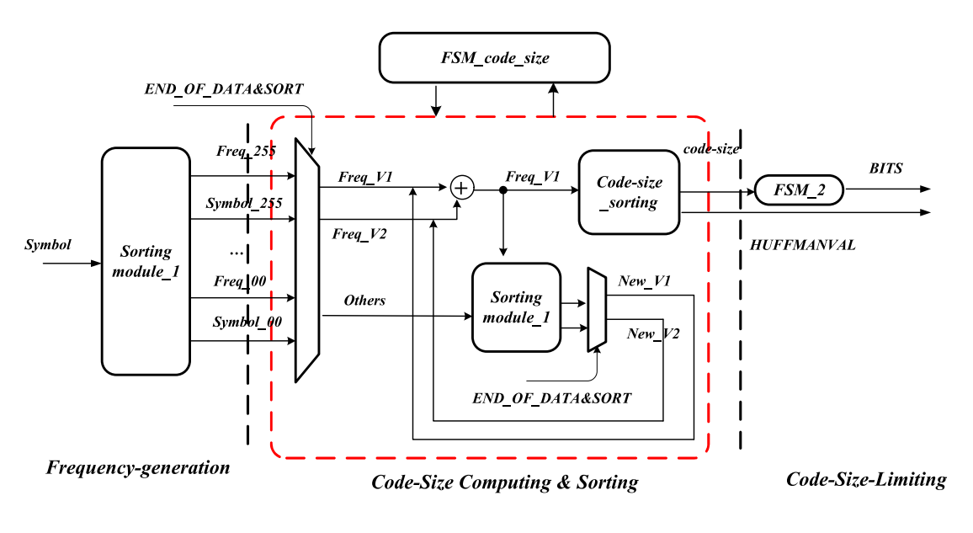

Slide 12
COMPONENTS/MODULES HUFFMAN BUFFER
The representation for each symbol, resulting in a prefix code. The bit string representing some particular symbol is never a prefix of the bit string representing any other symbol.
INPUT: A B B C D B C C D A A B B E E E B E A B ( 160 Bits)
01 11 11 101 100 11 101 101 100 01 01 11 11 00 00 00 11 00 01 11 ( 45 BITS)

Slide 13
FREQUENCY COUNT
The tally or frequency count is the calculation of how many people fit into a certain category or the number of times a characteristic occurs.
A = 4 Times B = 7 Times C = 3 Times D = 2 Times E = 4 Times

Slide 14
SORTING
Sort’s the characters in increasing order of the frequency. These are stored in a priority queue.
2 | 3 | 4 | 4 | 7
D | C | E | A | B

Slide 15
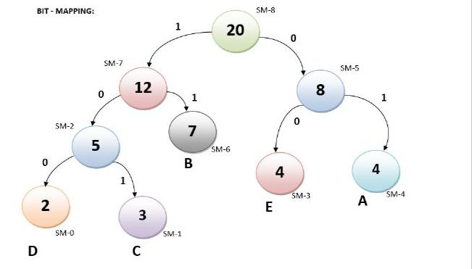
BIT MAPPING
Bit mapping is procedure of assigning codewords to length n in codeword stream.

Slide 16
CODE TABLE
Code table is specified by two lists, BITS and HUFFVAL. BITS is a 16-byte array contained in the codeword stream where byte n simply gives the number of codewords of length n that are present in the code table.
A | 01
B | 11
C | 101
D | 100
E | 00

Slide 17
ADVANTAGES
High encoding efficiency regarding delay and power consumption.
Reduces the time consumption of the pre-scan
Reduces the required clock cycle effectively
Less number of memories

Slide 18
TIMELINE

Slide 19


SOFTWARE
XILINX VIVADO 2022.2
MODEL SIM 6.5b

Slide 20
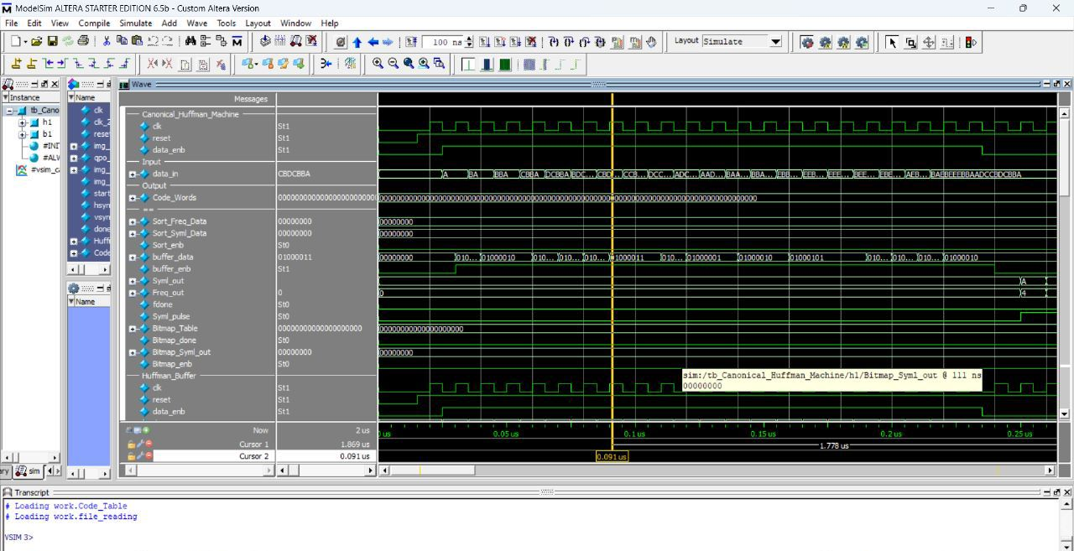
SIMULATION

Slide 21
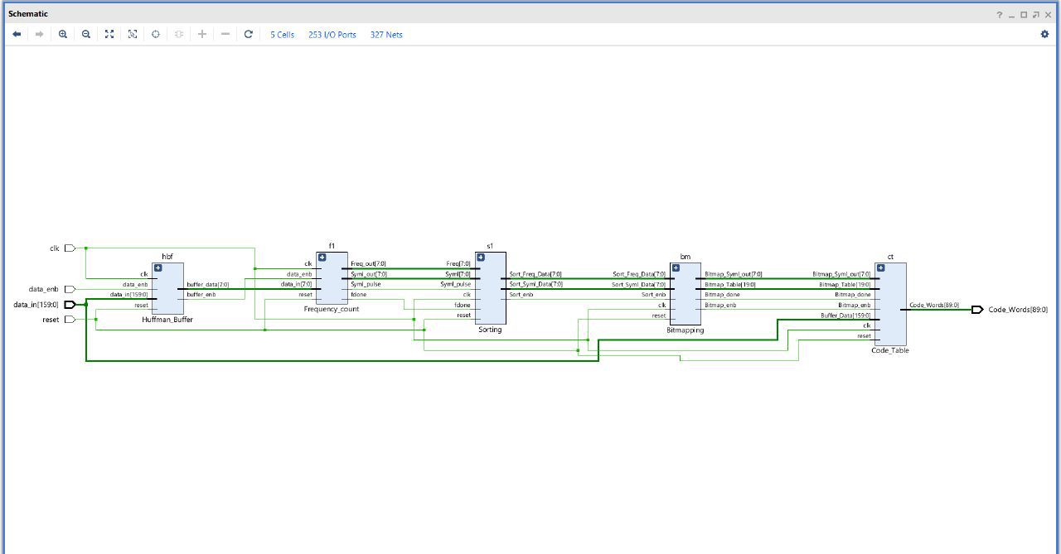
SYNTHESIS

Slide 22
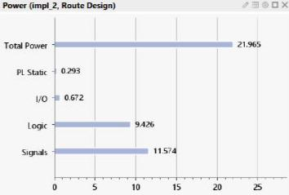
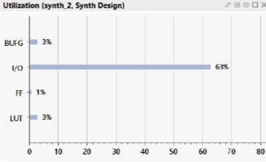
REPORT
POWER REPORT UTILIZATION REPORT

Slide 23
RESULT
A B B C D B C C D A A B B E E E B E A B ( 160 Bits)
01 11 11 101 100 11 101 101 100 01 01 11 11 00 00 00 11 00 01 11 ( 45 BITS)
COMPRESSOR Data Code Word Canonical Form :{2,01}, {2,11}, {2,11}, {3,101}, {3,100}, {2,11}, {3,101}, {3,101}, {3,100}, {2,01}, {2,01}, {2,11}, {2,11}, {2,00}, {2,00}, {2,00}, {2,11}, {2,00}, {2,01}, {2,11}
OUTPUT: {10,01}, {10,11}, {10,11}, {011,101}, {000,100}, {10,11}, {011,101}, {011,101}, {000,100}, {10,01}, {10,01}, {10,11}, {10,11}, {10,00}, {10,00}, {10,00}, {10,11}, {10,00}, {10,01}, {10,11} ( 90 BITS)
COMPRESSION RATIO= INPUT BITS / OUTPUT BITS= 160/ 90= 1.77

Slide 24
REFERENCES
D. A. Huffman, “A method for the construction of minimum-redundancy codes,” Proc. IRE, vol. 40, no. 9, pp. 1098–1101, Sep. 1952.
S. J. Sarkar, N. K. Sarkar, and A. Banerjee, “A novel Huffman coding based approach to reduce the size of large data array,” in Proc. Int. Conf. Circuit Power Comput. Technol. (ICCPCT), Nagercoil, India, 2016, pp. 1–5.
Y. Liu and L. Luo, “Lossless compression of full-surface solar magnetic field image based on Huffman coding,” in Proc. IEEE 2nd Inf. Technol. Netw. Electron. Autom. Control Conf. (ITNEC), Chengdu, China, 2017, pp. 899–903.
R. B. Patil and K. D. Kulat, “Audio compression using dynamic Huffman and RLE coding,” in Proc. 2nd Int. Conf. Commun. Electron. Syst. (ICCES), Coimbatore, India, 2017, pp. 160–162.

Slide 25
N. Markandeya and S. Patil, “Improve information rate in Thien and Lin’s image secret sharing scheme using Huffman coding technique,” in Proc. Int. Conf. Comput. Commun. Control Autom. (ICCUBEA), Pune, India, 2017, pp. 1–5.
S. V. Keerthy, T. K. C. R. Kishore, B. Karthikeyan, V. Vaithiyanathan, and M. M. A. Raj, “A hybrid technique for quadrant based data hiding using Huffman coding,” in Proc. Int. Conf. Innovat. Inf. Embedded Commun. Systems (ICIIECS), Coimbatore, India, 2015, pp. 1–6.
S. J. Lee, K. H. Yang, J. S. Song, and C. W. Lee, “An efficient memory allocation scheme for Huffman coding of multiple sources,” Signal Process. Image Commun., vol. 14, pp. 311–323, Jan. 1999.

Slide 26
THANK YOU

